Slide 1
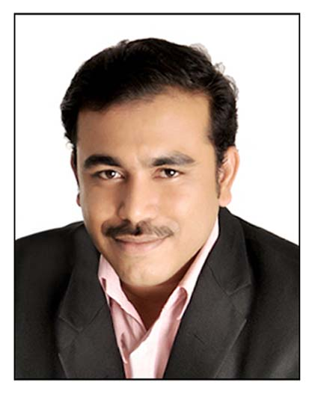
PROFILE
WORK EXPERIENCE
Telecom OSS/BSS Architect having led several B2B and B2C Telecom transformation and Consulting projects in Wireless, Wireline, Cable and Broadband for North America, UK and Indian CSP’s
17 years of experience in Order 2 Cash, Order 2 Activate, Trouble 2 Resolve Telecom and Service Assurance business process and implementations
Worked on Architecture Assessment, Business Process Reengineering, Consulting and Digital Transformation assignments as a Telecom OSS/BSS SME leveraging TM Forum’s eTOM, TAM, SID and ODA
Have led several Telecom implementations for Wireless, Wireline, Cable, Broadband and Content Billing for North America, UK and Indian CSP’s
Experience in many phases of software development methodology including consulting, product strategy, requirements specification, design, implementation, and delivery
Have delivered Telecom solutions through several SaaS and COTS products
Expertise in Telecom OSS/BSS Business Process, Enterprise Architecture and Project Delivery of Transformation Projects
Telecom BSS - Order 2 Cash (CRM, Billing, Mediation)
Telecom OSS - Order 2 Activate (Order Management, Network Inventory, Geospatial OSP), Trouble 2 Resolve (Troubleticketing, Alarms Management, AI/ML for Predictive Network Alarms)
TM Forum (eTOM, TAM, SID and ODA), TOGAF, BPMN
Key Solutions engineered and delivered
Implemented Salesforce Vlocity CPQ Integrations for a North American Tier 1 client for their B2B line of business
Implemented Transformation Projects in Telecom B2B, B2C area involving Product Catalog, CRM, Billing and Mediation for North American Tier 2 and a Canadian CSP
Implemented Service Assurance involving ServiceNow for Tier 2 Quad Play NA CSP
Defined Future State roadmap for a Quad Play NA CSP in core OSS area
Reverse Engineering / Legacy Modernization for a Tier 1 CSP in North America from their existing legacy mainframe system
Sandeep Ubhaykar​​​
Telecom BSS/OSS Architect
LOCATION
India
SKILLS AND COMPETENCIES
QUALIFICATIONS | Bachelor of Science (IT), Diploma in Chemical Engineering
FUNCTIONAL ROLES | Telecom OSS/BSS SME, Enterprise Architect, Project Manager
TELECOM BSS/OSS | COTS/SaaS Products: Salesforce Vlocity, ServiceNow,Oracle RODOD (Siebel, BRM, AIA, OSM, UIM), Amdocs Kenan CPQ: Vlocity CPQ, CloudSense CPQ Billing: Oracle BRM, Amdocs Kenan, Jbilling, ARIA Mediation & Rating: Oracle Mediation, Kenan Data Mediation, Volubill Differential Billing Platform, Comptel Online Link OSS Products: Sitetracker, Ciena Blue Planet Inventory, Ciena Blue Planet UAA, GE Smallworld Geospatial OSP
TECHNOLOGY PLATFORMS | Cloud Native Technologies, Dev Ops, AWS, Azure, Java/J2EE, Weblogic Tuxedo, Tibco Spotfire, Informatica, C, Pro C, Oracle PL/SQL, UNIX Shell Scripts, VB/ASP, XML, .NET, Visual Source Safe, and Testing tools, Micro Focus Enterprise Analyzer, Evolve ware, Microsoft Project
EA TOOLS | SPARX Enterprise Architect, Orbus iServer
APP MONITORING | Science Logic, App Dynamics
LANGUAGES
English
EXPERIENCE
17 years

